Slide 1
Lab

Slide 2
Q1
Model the following fragment of a business process for assessing loan applications.
Once a loan application has been approved by the loan provider, an acceptance pack is
prepared and sent to the customer. The acceptance pack includes a repayment schedule
which the customer needs to agree upon by sending the signed documents back to the loan
provider. The latter then verifies the repayment agreement: if the applicant disagreed with
the repayment schedule, the loan provider cancels the application; if the applicant agreed,
the loan provider approves the application. In either case, the process completes with the
loan provider notifying the applicant of the application status.

Slide 3
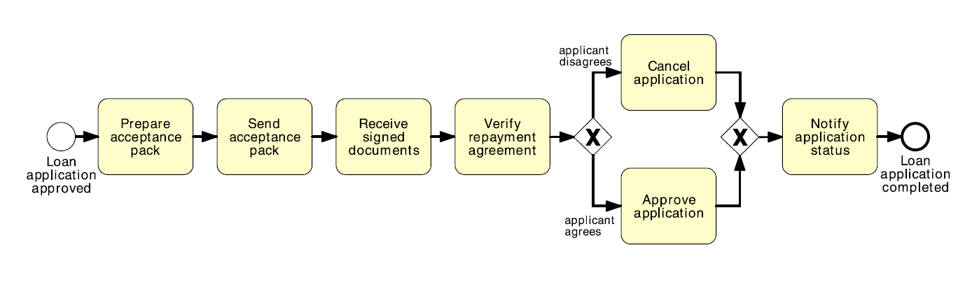

Slide 4
Q2
Model the following fragment of a business process for assessing loan applications.
A loan application is approved if it passes two checks: (i) the applicant’s loan risk assessment,
done automatically by a system, and (ii) the appraisal of the property for which the
loan has been asked, carried out by a property appraiser. The risk assessment requires a
credit history check on the applicant, which is performed by a financial officer. Once both
the loan risk assessment and the property appraisal have been performed, a loan officer can
assess the applicant’s eligibility. If the applicant is not eligible, the application is rejected,
otherwise the acceptance pack is prepared and sent to the applicant

Slide 5
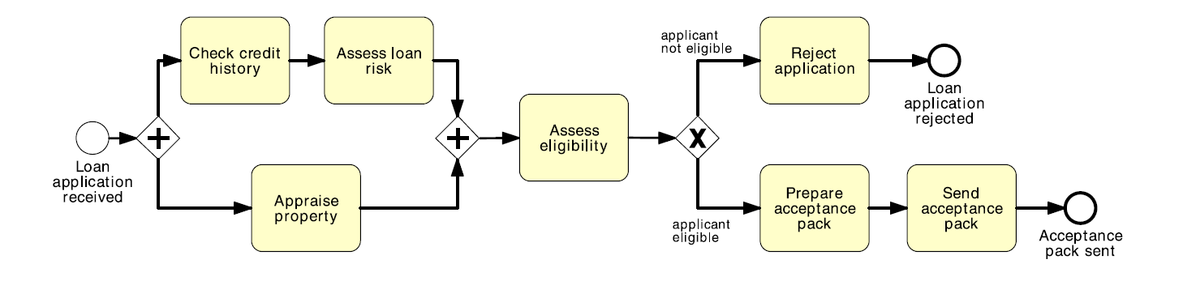

Slide 6
Q3
Model the following fragment of a business process for assessing loan applications.
A loan application may be coupled with a home insurance which is offered at discounted
prices. The applicant may express their interest in a home insurance plan at the time of
submitting their loan application to the loan provider. Based on this information, if the
loan application is approved, the loan provider may either only send an acceptance pack
to the applicant, or also send a home insurance quote. The process then continues with the
verification of the repayment agreement.

Slide 7
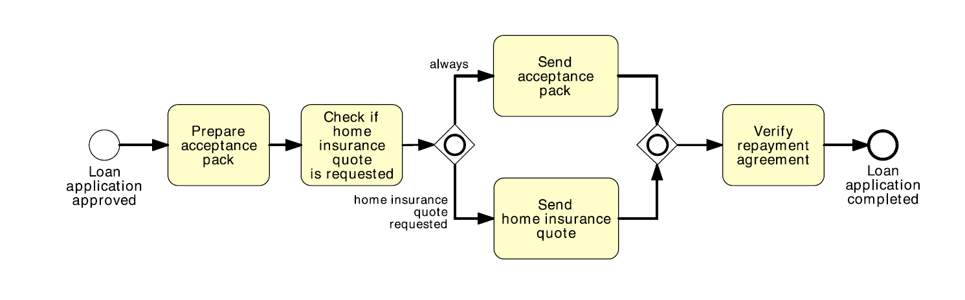

Slide 8
Q4
Model the following fragment of a business process for assessing loan applications:
Once a loan application is received by the loan provider, and before proceeding with its
assessment, the application itself needs to be checked for completeness. If the application is
incomplete, it is returned to the applicant, so that they can fill out the missing information
and send it back to the loan provider. This process is repeated until the application is found
complete.

Slide 9
